Slide 1

PS3 DSIVE TEAM
Final Presentation: Cell Broadband Engine (CBE) Real World Application
12/10/2007
Sponsored by:

Slide 2
Group Members
Syed Ali
Mechanical/Electrical Engr
Paul Ireifej
Comp Systems Engr / Computer Science
Justin Law
Comp Systems Engr
Carlos Lazo
Comp Systems Engr
Tarzi Mahmutcan
Comp Systems Engr / Computer Science
Nick Matthews
Comp Systems Engr / Computer Science
Shahab Rastegar
Electrical Engr
Thomas Smith
Comp Systems Engr
Notes:
Carlos

Slide 3
Outline
Sponsors
Objectives
System Design & Demonstrations
Accomplishments
Open Issues & Recommendations
Conclusions

Slide 4
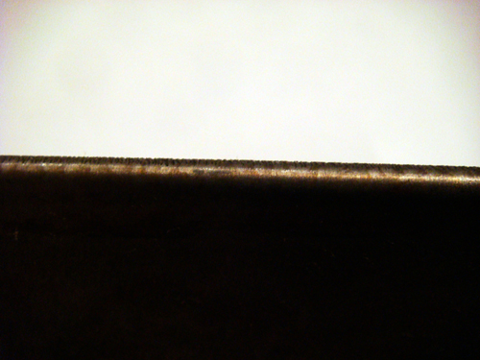
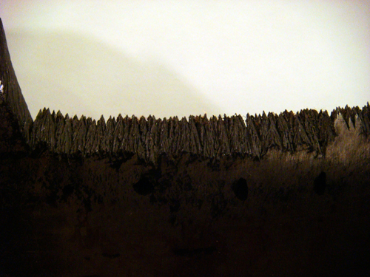
Problem

Slide 5
IBM
Explore viability of O/S installation on the PS3
Research usability/capabilities of the CBE
Develop a new application that harnesses the computational power of the CBE
Utilize IBM’s development tools (IBM CBE SDK)
Realistically assess the CBE learning curve over a 3 month period

Slide 6
GE
Develop a non-invasive system to measure the rate of metallic erosion on steam turbines
Implement a modular unit that can interface with the turbines using existing mechanical portals
Automate the task of measuring, quantifying and reporting erosion levels

Slide 7
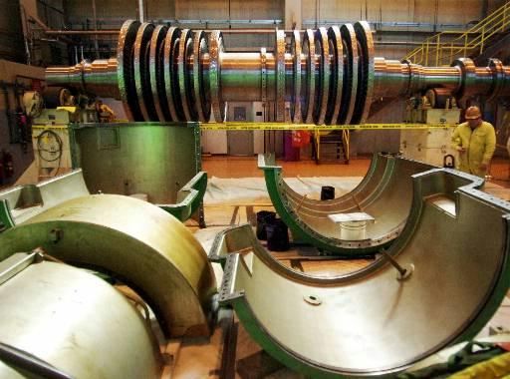
Current Industrial Solution
Manually Open
Disadvantages
$500,000 per Service
Complicated Process
Unknown Rate of Erosion

Slide 8
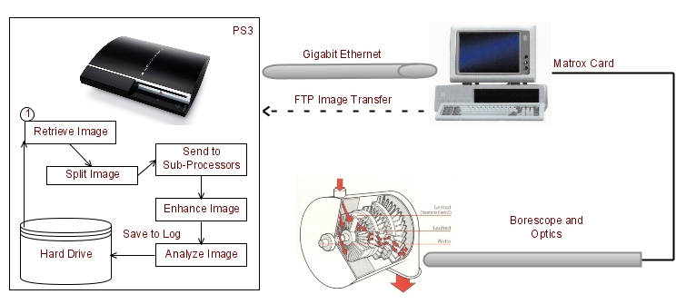
Proposed System Architecture

Slide 9
Semester Objectives
Install O/S
Install IBM SDK for development
Establish network connectivity & access
Create image capture hardware for simulation
Communicate with PS3 via FTP
Analyze image in PGM format
Utilize the parallel computing power of the CBEA
Implement parallel processing via multi-threading
Optimize software code for multiple processors
Optimize PGM images for image processing
Develop image processing and analysis algorithm
Create output log

Slide 10
Design Methodology & Strategy
Model & prototype ideas in MATLAB
Code translated into C from MATLAB
Successfully port and run functions on PS3 using Cell SDK Environment
Vectorize code
Concurrently build simulation hardware for future independent image testing

Slide 11
Imaging Concepts Considered
Subtraction
Consistent lighting
Requires prefect alignment
Average Distance
Sufficient lighting on the edge of the blade, and on the scribed line.
Edge Size Standard Deviation
The total number of steps needed to implement this method is greater than the other two methods.
Matrox based Level Setting Edge Detection
Level Setting Edge Detection
Complex mathematics
Difficult to implement outside of MatLab
High Pass Filter Edge Detection
Least process intensive
Easily implemented
Sufficient accuracy

Slide 12
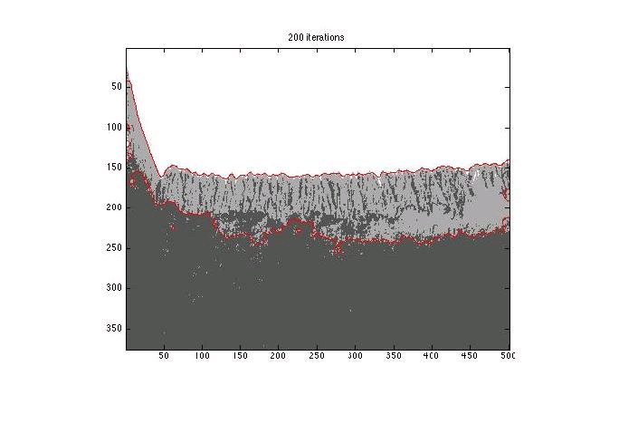
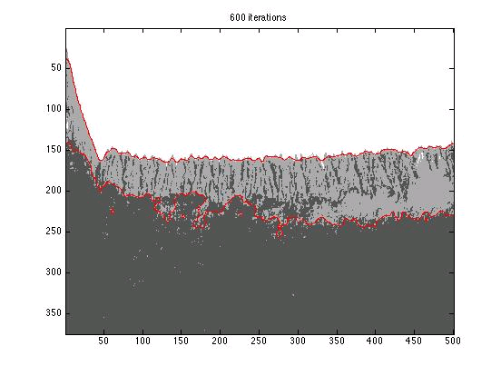
Demonstration Level Setting
Contour Technique
Tracks changes in shapes
Types of shapes: splits, hole development and geometric deviations
Time variant function
Based on number of iterations for accuracy

Slide 13
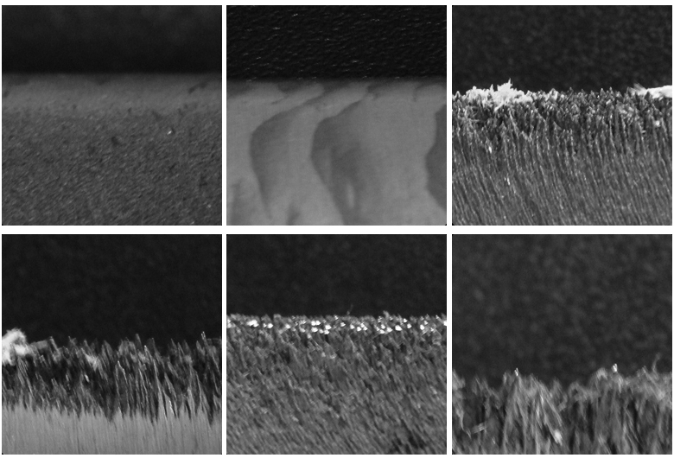
Demonstration MatLab Edge Detection

Slide 14

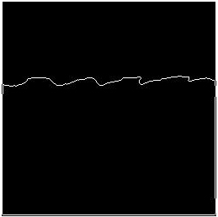
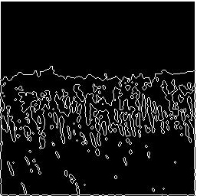
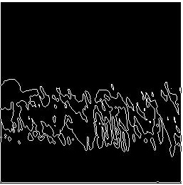
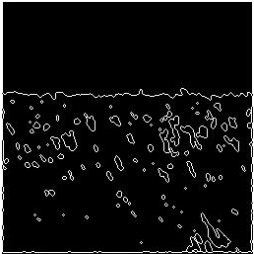
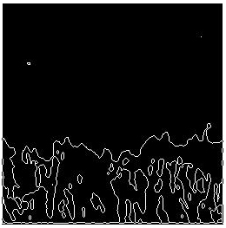
Demonstration MatLab Edge Detection
Average Displacement: 2 Standard Deviation: 0.651
Average Displacement: 15 Standard Deviation: 3.419
Average Displacement: 17 Standard Deviation: 4.196
Average Displacement: 51 Standard Deviation: 14.204
Average Displacement: 15 Standard Deviation: 1.910
Average Displacement: 86 Standard Deviation: 12.422

Slide 15
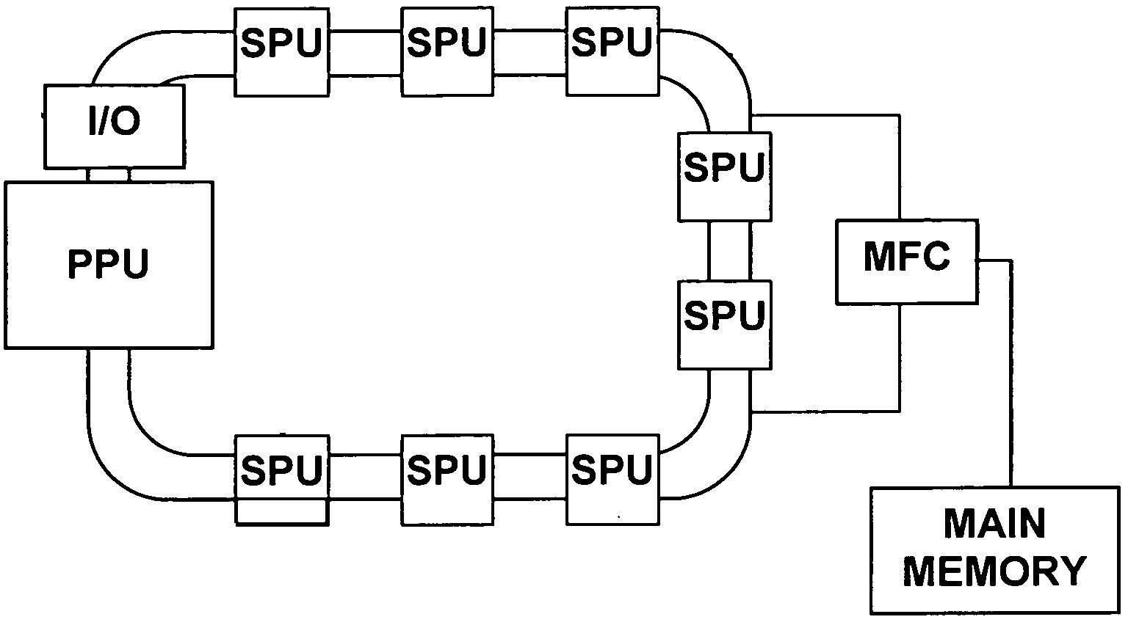
System Design PPU / SPU Information Exchange
One Power Processing Element (PPE) that controls eight Synergistic Processing Elements (SPE)
Team is using SDK 2.1 and “libspe2.h”
Each SPE includes a Memory Flow Control (MFC) that includes direct memory access

Slide 16
Demonstration PPU / SPU Information Exchange
Size of Square Matrix | Convolution on ThinkPad T61 | Convolution on PPE | Estimated with PPU/SPU parallel processing (4 SPE’s)
10 | < 10 ms | < 10 ms | < 10 ms
100 | 10 ms | 10 ms | 2.5 ms
255 | 28 ms | 60 ms | 15 ms
500 | 98 ms | 230 ms | 57.5 ms
1000 | 485 ms | 940 ms | 235 ms
2048 | 1,705 ms | 3,930 ms | 982.5 ms
5096 | 10,181 ms | 26, 570 ms | 6,642.5 ms

Slide 17
System Design
FTP Connection from Image capture hardware
Convert Image format to PGM
PS3 Hard drive
Segment image colors
Blur image with blur kernel
Create Matrix with int_matrix function
Implement edge detection
Calculate Standard Deviation
Output

Slide 18
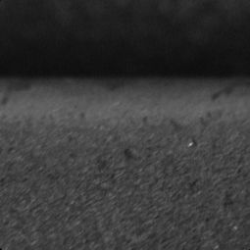
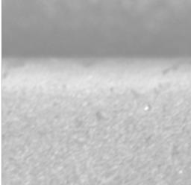
System Design
Shell script developed for linking code together
Manual runs performed on test images
Accuracy of timer in hundredths of a second
Estimated times:
Intel Processor on T61: 1-2 seconds
PS3 PPU: 60 ms (approximately 10 ms/operation)
BEFORE
AFTER
End to End System

Slide 19
System Design Simulation Hardware
Testing Apparatus for End-to-End System
Serves as a Simplified Image Capturing System for PS3 Erosion Image Analysis
Consists of a Turbine Simulator and an Image Capturing System
Projects can be Easily Integrated Together

Slide 20
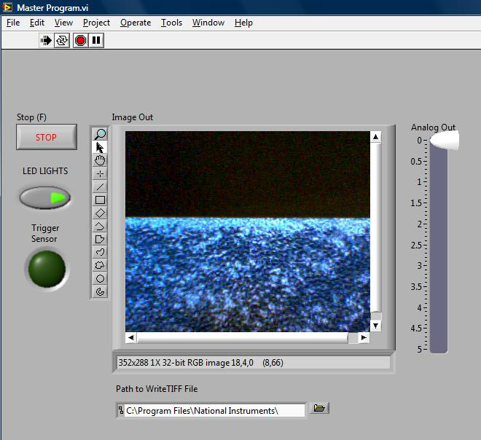
Demonstration Simulation Hardware

Slide 21
Accomplishments
Linux O/S installation and connectivity
Image processing analysis and implementation
Code development and migration to PS3
Successful parallel communication with four PS3 sub-processors
End-to-end system with time estimates
Mechanical construction of simulation hardware

Slide 22
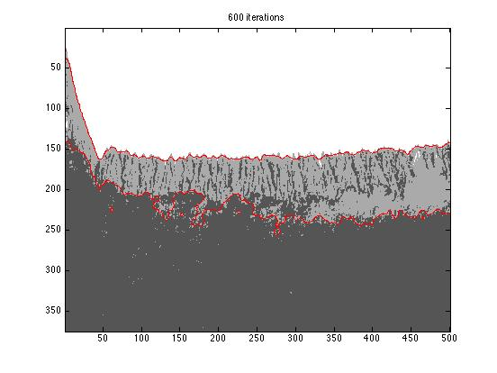
Open Issues & Recommendations Image Processing
Require static variables
Unresolved code issues
Accuracy of edge detection
FTP script not implemented

Slide 23
Open Issues & Recommendations PPU / SPU Information Exchange
Unable to send an array parameter to an SPE
Function “mfc_get” initiates a transfer into the local store and function “mfc_put” initiates a transfer back into main memory
When including “spu_mfcio.h”, “spu_internals.h” returns error with “vec_float4” type
Recommendation: Begin development with SDK 3.0

Slide 24
Recommendations Simulation Hardware
More Complex LabView Program/Control
Faster Camera (1/1000 Minimum Shutter)
Use NI USB 6009 DAQ Card (Less Lag Time)
Use White LEDs & Better Turbine Blade Model
Configure FTP Connection for PS3
Use Windows XP for LabView (DAQ Drivers)

Slide 25
Conclusions
Image processing algorithms heavily dependant on quality & content of image
IBM SDK suitable for project
Automated image analysis would be worthwhile for GE
Cell broadband processor surpasses processing power needed for current image algorithms

Slide 26
Lessons Learned
PS3 Cell Architecture and Linux O/S learning curve is steep given the time period
One will face unexpected problems with the PS3 cell processor (uncharted territory)
Sub team communication integral to the speed and success of the project
Worthwhile to provide an entry level module to the Cell Processor

Slide 27
*** THANK YOU FOR THIS OPPORTUNITY ***
QUESTIONS ?

